Slide 1


Exploratory Data Analysis of Financial Loan Dataset

Slide 2
PROBLEM STATEMENT
Financial institutions deal with large volumes of loan data, including application details, loan amounts, approval status, income levels, and more. However, without effective analysis, it is difficult to identify key patterns, evaluate risks, and make informed lending decisions.
This project aims to analyze and visualize financial loan data using Tableau to uncover trends, detect high-risk categories, track loan performance over time, and provide actionable insights for better decision-making and risk management.

Slide 3

PROJECT OBJECTIVE
To analyze loan application data and identify key trends.
To visualize loan distribution by status, amount, and time period.
To detect patterns in customer behavior and risk segments.
To create interactive dashboards for better decision-making.
To gain insights on how income, location, and date affect loan outcomes.

Slide 4
DATA DESCRIPTION
Data Source: financial_loan.csv
Total Records: 982
Key Columns:
loan_id, issue_date, loan_amount
loan_status, customer_income, term, purpose
location/state, interest_rate, employment_status

Slide 5
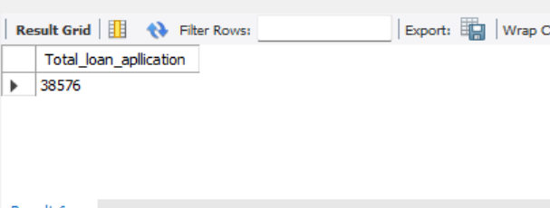
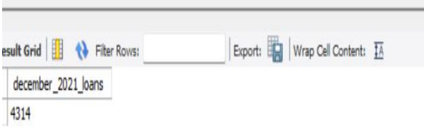
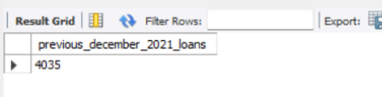
SQL Queries
Total loan application
Month-to-date
total Application
PMTD loan applications
paragraph text
select count(id)as
Total_loan_apllication
from financial_loan;
SELECT COUNT(id) AS December_2021_loans
FROM financial_loan
WHERE issue_date
BETWEEN '01-01-2021' AND '31-12-2021';
SELECT COUNT(id) AS
Previous_December_2021_loans
FROM financial_loan
WHERE issue_date
BETWEEN '01-11-2021'
AND '30-11-2021';

Slide 6
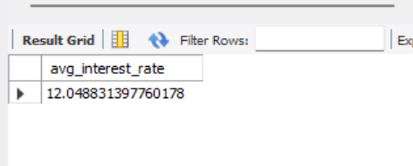
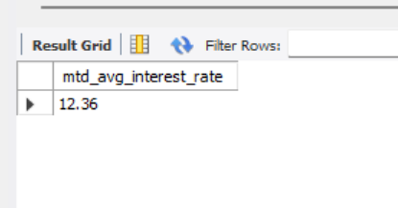
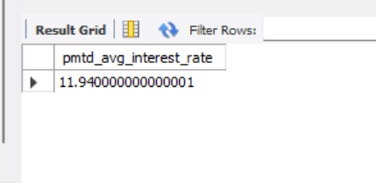
Avg interest rate
MTD Avg Interest Rate
PMTD Avg Interest Rate
select avg(int_rate)*100
As avg_interest_rate
from financial_loan;
select round(avg(int_rate), 4)*100
As mtd_avg_interest_rate
from financial_loan
where str_to_date
(issue_date ,' %d-%m-%Y')
between '2021-01-01' and '2021-12-31';
select round(avg(int_rate), 4)*100
As pmtd_avg_interest_rate
from financial_loan
where str_to_date
(issue_date ,' %d-%m-%Y')
between '2021-11-01' and '2021-11-30';

Slide 7
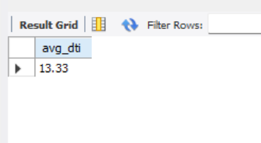
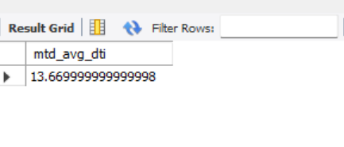
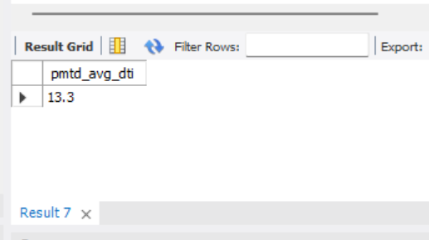
AVG DTI
MTD AVG DTI
PMTD AVG DTI
select round(avg(dti),4)*100 as
mtd_avg_dti from
financial_loan
where str_to_date(issue_date , '%d-%m-%Y')
between '2021-12-01' and '2021-12-31';
select round(avg(dti),4)*100 as pmtd_avg_dti
from financial_loan
where str_to_date
(issue_date , '%d-%m-%Y')
between '2021-11-01’
and '2021-11-30';
select round(avg(dti) , 4)*100
as avg_dti
from financial_loan;

Slide 8
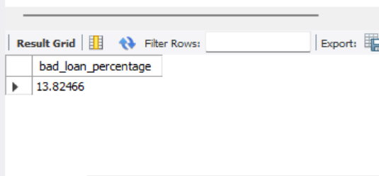
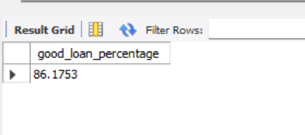
Good Loan
Bad Loan
select
(count(case when loan_status = 'Charged Off' then id end )*100.0) /
count(id) as bad_loan_percentage
from financial_loan;
select
(count(case when loan_status = 'Fully Paid' or loan_status = 'Current' then id end)*100)/
count(id) as good_loan_percentage
from financial_loan;

Slide 9
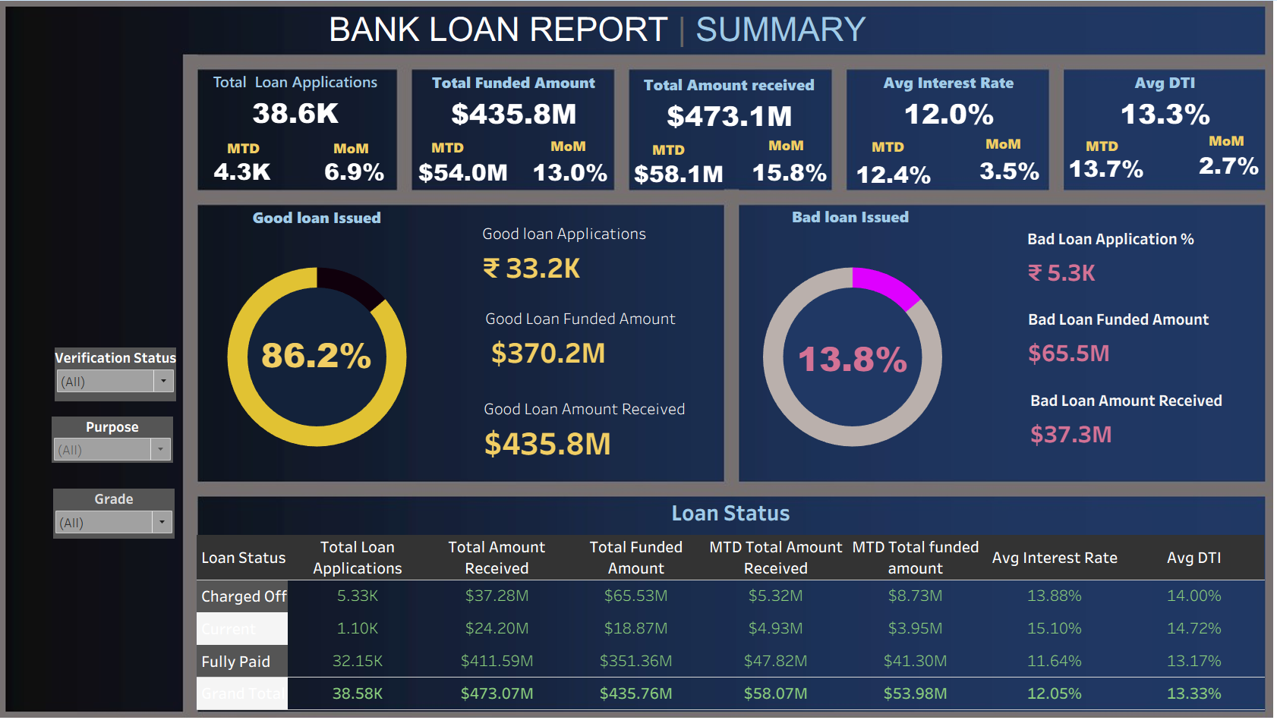
Dashboard

Slide 10
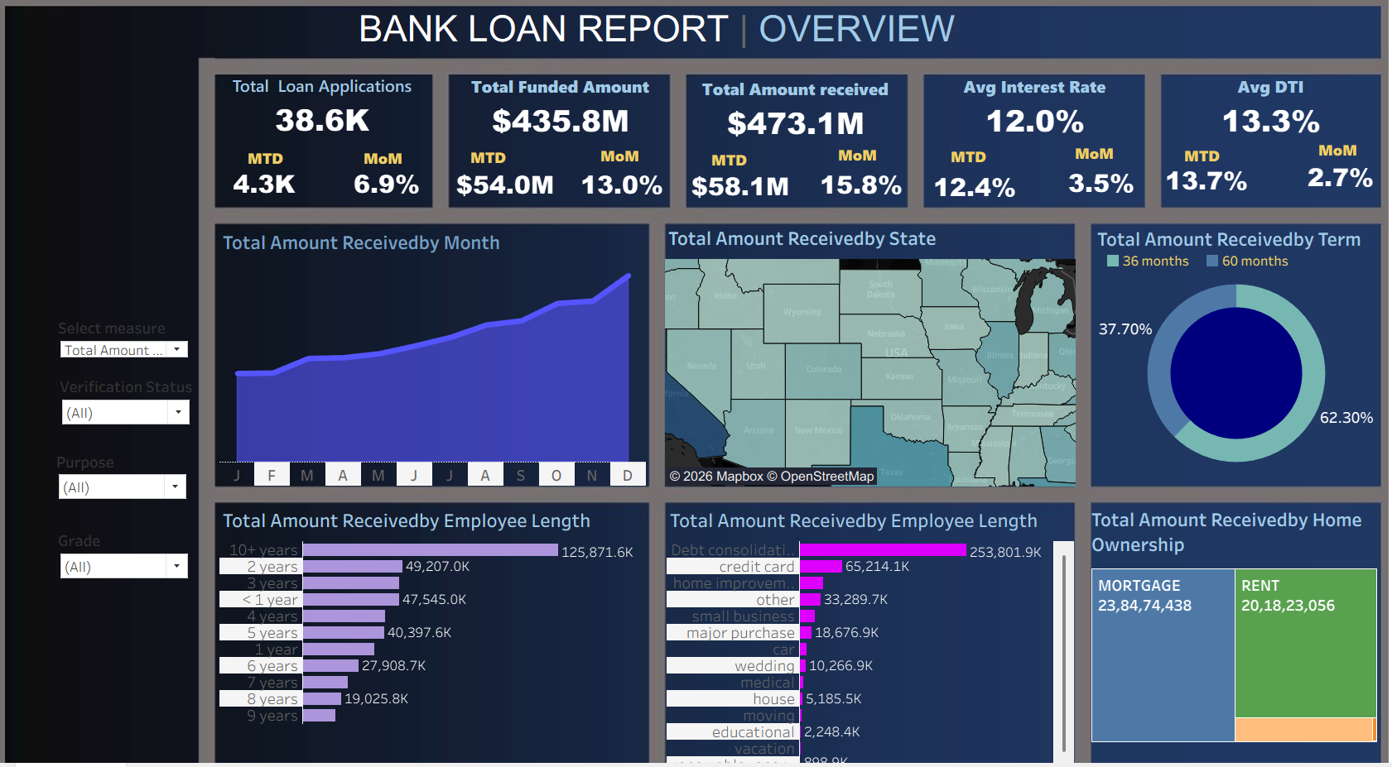

Slide 11
Tools and Technologies used
Excel
MySql
Tableau
Opened the raw .csv file to understand the dataset.
Reviewed column headers, data types, and sample values
Calculated monthly totals, average loan amounts, and status distributions using GROUP BY and SUM, COUNT, AVG functions.
Enabled quick understanding of loan trends, approval rates, and financial patterns through charts and dashboards.

Slide 12
01
02
Loan Amount by Income Group
Monthly Funding Pattern
Key
Insights
Higher income groups (above ₹75,000/month) applied for larger loan amounts.
Low-income individuals typically applied for smaller short-term loans.
The total funded loan amount peaked in December, aligning with year-end expenses.
Loan funding is lowest during April–June.
03
04
Impact of Employment Status
Loan Purpose Analysis
The top three reasons for loans were: Home Renovation, Debt Consolidation, and Business Expansion.
Education loans had a higher rejection rate due to low collateral.
Salaried employees had a higher approval rate compared to self-employed individuals.
Unemployed or part-time applicants had a higher rejection rate

Slide 13
Risk Assessment: One of the primary purposes of analysing loan data is to assess the risk associated with lending to a particular individual or business. Banks use data to evaluate the creditworthiness of borrowers, predict default probabilities, and determine interest rates and lending terms.
Reasons for Analyzing
bank
loan data
Decision-making: Loan data analysis supports the decision-making process when evaluating loan applications. Banks use data-driven models and algorithms to make informed lending decisions, such as approving or denying loan requests.
Fraud Detection: Banks use data analysis to detect fraudulent loan applications and activities. Unusual patterns, inconsistencies, or discrepancies in loan data can trigger fraud alerts.
Customer Insights: Analysing loan data provides insights into customer behaviour, preferences, and needs. Banks can use these insights to tailor loan products and marketing strategies to specific customer segments.

Slide 14
Thank you

